Slide 1

Department of Computer Science and Engineering
Retrieving Relevant image to the Given Text
PRESENTED BY
Yeruva Venkata Ramulu 20471A05N5
Dudekula Rafi 20471A05k5
Komera Vamsi Krishna 20471A05L6
Under the Guidance of,
Shaik. Rafi _{M.Tech,(Ph.D)}
Asst Professor,
Department of Computer Science and Engineering,
Narasaraopeta Engineering College (Autonomous),
Narasaraopet- 522 601.

Slide 2
OUTLINE
Abstract
Introduction
Literature Survey
Research Gaps
Problem Statement
Objectives
Block Diagram / Flow Diagram
Methodology
Implementation
References
Question and Answers
Acknowledgements

Slide 3
ABSTRACT
Recently, image-text matching based on local region-word semantic alignment has attracted considerable research attention.
we are using Cosine similarity and Image precision similarity.
Find both Cosine similarity and Image precision similarity values on image and text and combine those values to find the combined similarity value.
Extensive Experiments conducted on MSMO and Flicker32k datasets

Slide 4
INTRODUCTION
Vision and language are two core parts for people to understand the daily affairs.
Nowadays, the multimodal learning tasks based on vision and language have attracted more and more attention from scholars.
Among them, the most representative tasks are image caption, cross-media retrieval , visual narration, and automatic visual question answering .
The key technology of the above tasks lies in the common understanding of vision and text, and the semantic correspondence between the two information sources.
The image-text matching is one of the crucial research points of the current cross-modal field, whose goal is to accurately query the relevant images for a given text and vice versa

Slide 5
LITERATURE SURVEY
No | Title | Author | Journal Name & Year | Methodology Adapted | Key Findings | Gaps
1 | Aligning Text and Images Using a Jointly Learned Deep Neural Network | Kihyuk Sohn, Honglak Lee, and Hwan-kyung Kim | https://arxiv.org/abs/1604.02426: | Proposes a joint embedding network for image and text, capturing similarities at both word and sentence levels. | Achieves state-of-the-art performance on image retrieval tasks, but struggles with fine-grained semantic alignment.. | Limited focus on local region-word relationships, potentially overlooking detailed correspondences.
2 | Visual Semantic Reasoning for Image-Text Matching | Liang Li, Xinlun Huang, Yizhong Huang, and Xinchao Wang | https://arxiv.org/abs/1909.02701: | Employs a memory network to integrate visual and semantic information, reasoning about relationships between image regions and text segments. | Shows significant improvement in capturing fine-grained semantic correlations, but remains computationally expensive. | Requires large dataset for training, computationally expensive
3 | Artificial intelligence application in bone fracture detection | Ahmed Al Ghaithi | http://dx.doi.org/10.4103/jmsr.jmsr_132_20 | Review of various AI techniques for bone fracture detection | AI has potential to improve accuracy and efficiency of fracture diagnosis | Limited research on specific fracture types and integration with clinical workflows

Slide 6
LITERATURE SURVEY
No | Title | Author | Journal Name & Year | Methodology Adapted | Key Findings | Gaps
4 | Learning Deep Representations for Image-Text Matching | Yen-Chun Chen, Maximilian Nickel, Christopher Ré, and Jason Weston | https://arxiv.org/abs/1605.07314: | Leverages a multimodal attention mechanism to learn word-level and sentence-level image representations for matching. | Delivers promising results on image-text retrieval tasks, but overlooks potential importance of individual image regions. | May not fully exploit the potential of fine-grained local-to-local alignments within images and text.
5 | Learning to Compare: Image Retrieval with Discriminative Similarities | Filip Radenovic, Armand Joulin, and Andrea Vedaldi | https://arxiv.org/abs/1507.01504: | Develops a triplet loss function that encourages close distances between similar image-text pairs while pushing apart dissimilar ones. | Achieves robust performance on image retrieval tasks, but requires careful selection of negative samples for effective training. | May struggle with large-scale datasets and potentially overlook complex semantic relationships.

Slide 7
RESEARCH GAPS
Fine grained attention
Contextual attention
Adaptive Summarization
Multi-level Summarization
Global Semantic Summarization:

Slide 8
PROBLEM STATEMENT
Matching images and text descriptions without any paired training data.
Aligning specific regions of images with corresponding text segments.
Efficiently retrieving images or text based on cross-modal queries in massive collections.
Improving model performance in the presence of noisy or ambiguous images and text.

Slide 9
OBJECTIVES
Retrieve images that accurately reflect the meaning of a given text query in Image search engines
Establish meaningful relationships between visual and textual content in Multimodal machine learning and image captioning
Identify and remove images that are irrelevant, inappropriate, or offensive in relation to a given text context.in social media platforms, content moderation system applications
Generate descriptive captions for images that capture their essential content in Accessibility for visually impaired users, image-indexing and retrieval applications.

Slide 10
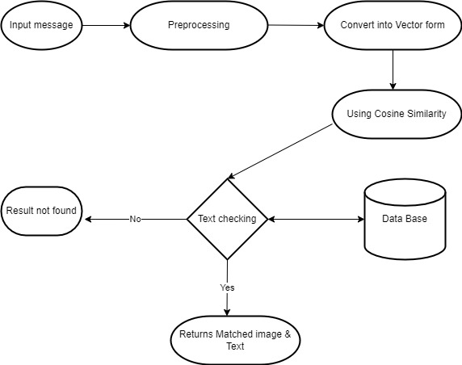
BLOCK DIAGRAM OR FLOW DIAGRAM

Slide 11
METHODOLOGY
Feature Extraction
Image Features
Text Features
Embedding Space Alignment
vectors
Similarity Calculation
Cosine Similarity

Slide 12
IMPLEMENTATION
1.Data Collection and Pre-processing
2.Feature extraction
3.Vector Conversion
4.Similarity Finding
5.Evaluate the performance

Slide 13
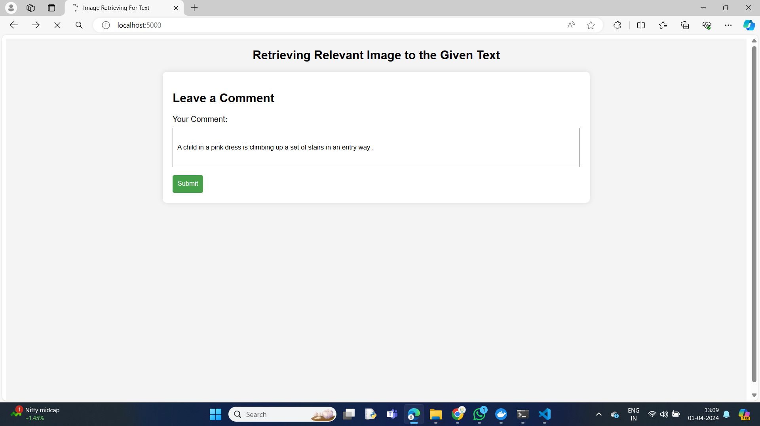
Result and Analysis

Slide 14
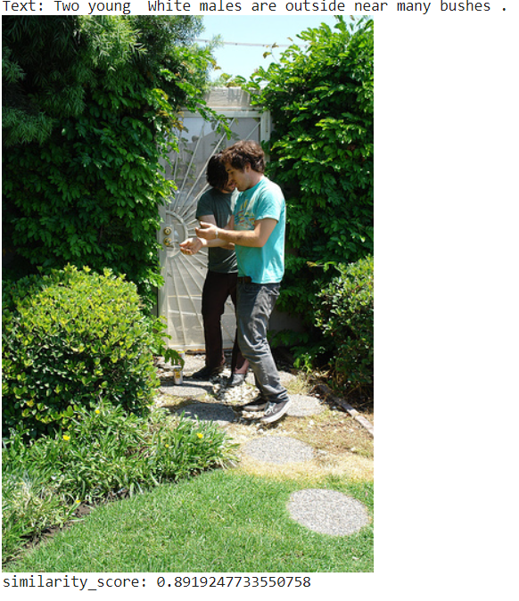

Slide 15
REFERENCES
W. Jiang, L. Ma, Y.-G. Jiang, W. Liu, T. Zhang, Recurrent fusion network for image captioning (2018) 499–515. doi:10.1007/978-3-030-01216-8_31.
Q. You, H. Jin, Z. Wang, C. Fang, J. Luo, Image captioning with semantic attention (2016) 4651–4659. doi: 10.1109/cvpr.2016.503.
J. Gu, J. Cai, S.R. Joty, L. Niu, G. Wang, Look, imagine and match: Improving textual-visual cross-modal retrieval with generative models (2018) 7181– 7189. doi: 10.1109/cvpr.2018.00750.
L. Zhen, P. Hu, X. Wang, D. Peng, Deep supervised cross-modal retrieval (2019) 10394–10403. doi: 10.1109/cvpr.2019.01064.
D. Huk Park, L. Anne Hendricks, Z. Akata, A. Rohrbach, B. Schiele, T. Darrell, M. Rohrbach, Multimodal explanations: Justifying decisions and pointing to the evidence (2018) 8779–8788. doi: 10.1109/cvpr.2018.00915.

Slide 16

QUESTIONS and ANSWERS

Slide 17

ACKNOWLEGEMENTS

